Slide 1


Slide 2
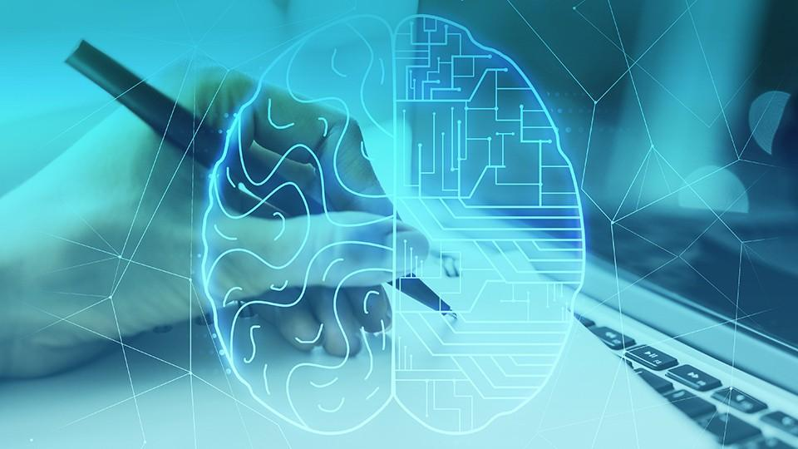
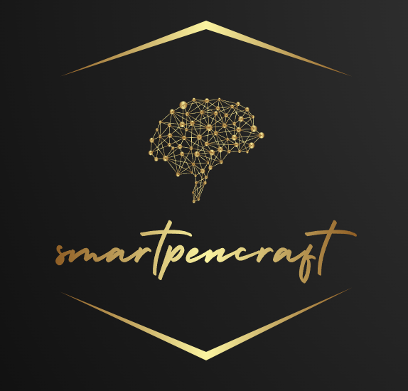
SmartPenCraft
Unleash the power of AI driven creativity with our content generator. Seamlessly blending human like-expression and deep learning capabilities, it sets new standards for efficiency and brilliance.
Solution of Problem Statement 2:
Design and develop an impressive tool that utilizes generative AI to generate content while maintaining the style and tone of the previously written content.

Slide 3

Want content for:
Blogging
Marketing
News Articles
Social Media
Technical Writing
Creating Writing
Many other things as well :)

Slide 4

Problems:
Time Consuming Content Creation
Limited Information Access
Lack of Personalization
Language Barriers
Content quality and Consistency
Writing error and Proofreading
Limited Creative Inspiration
Accessibility Issues

Slide 5

Project Objectives:
Automated Content Creation
Enhance Content Efficiency
Improve Content Quality
User friendly Interface
Accessibility features
Error-free Content
Security and privacy

Slide 6
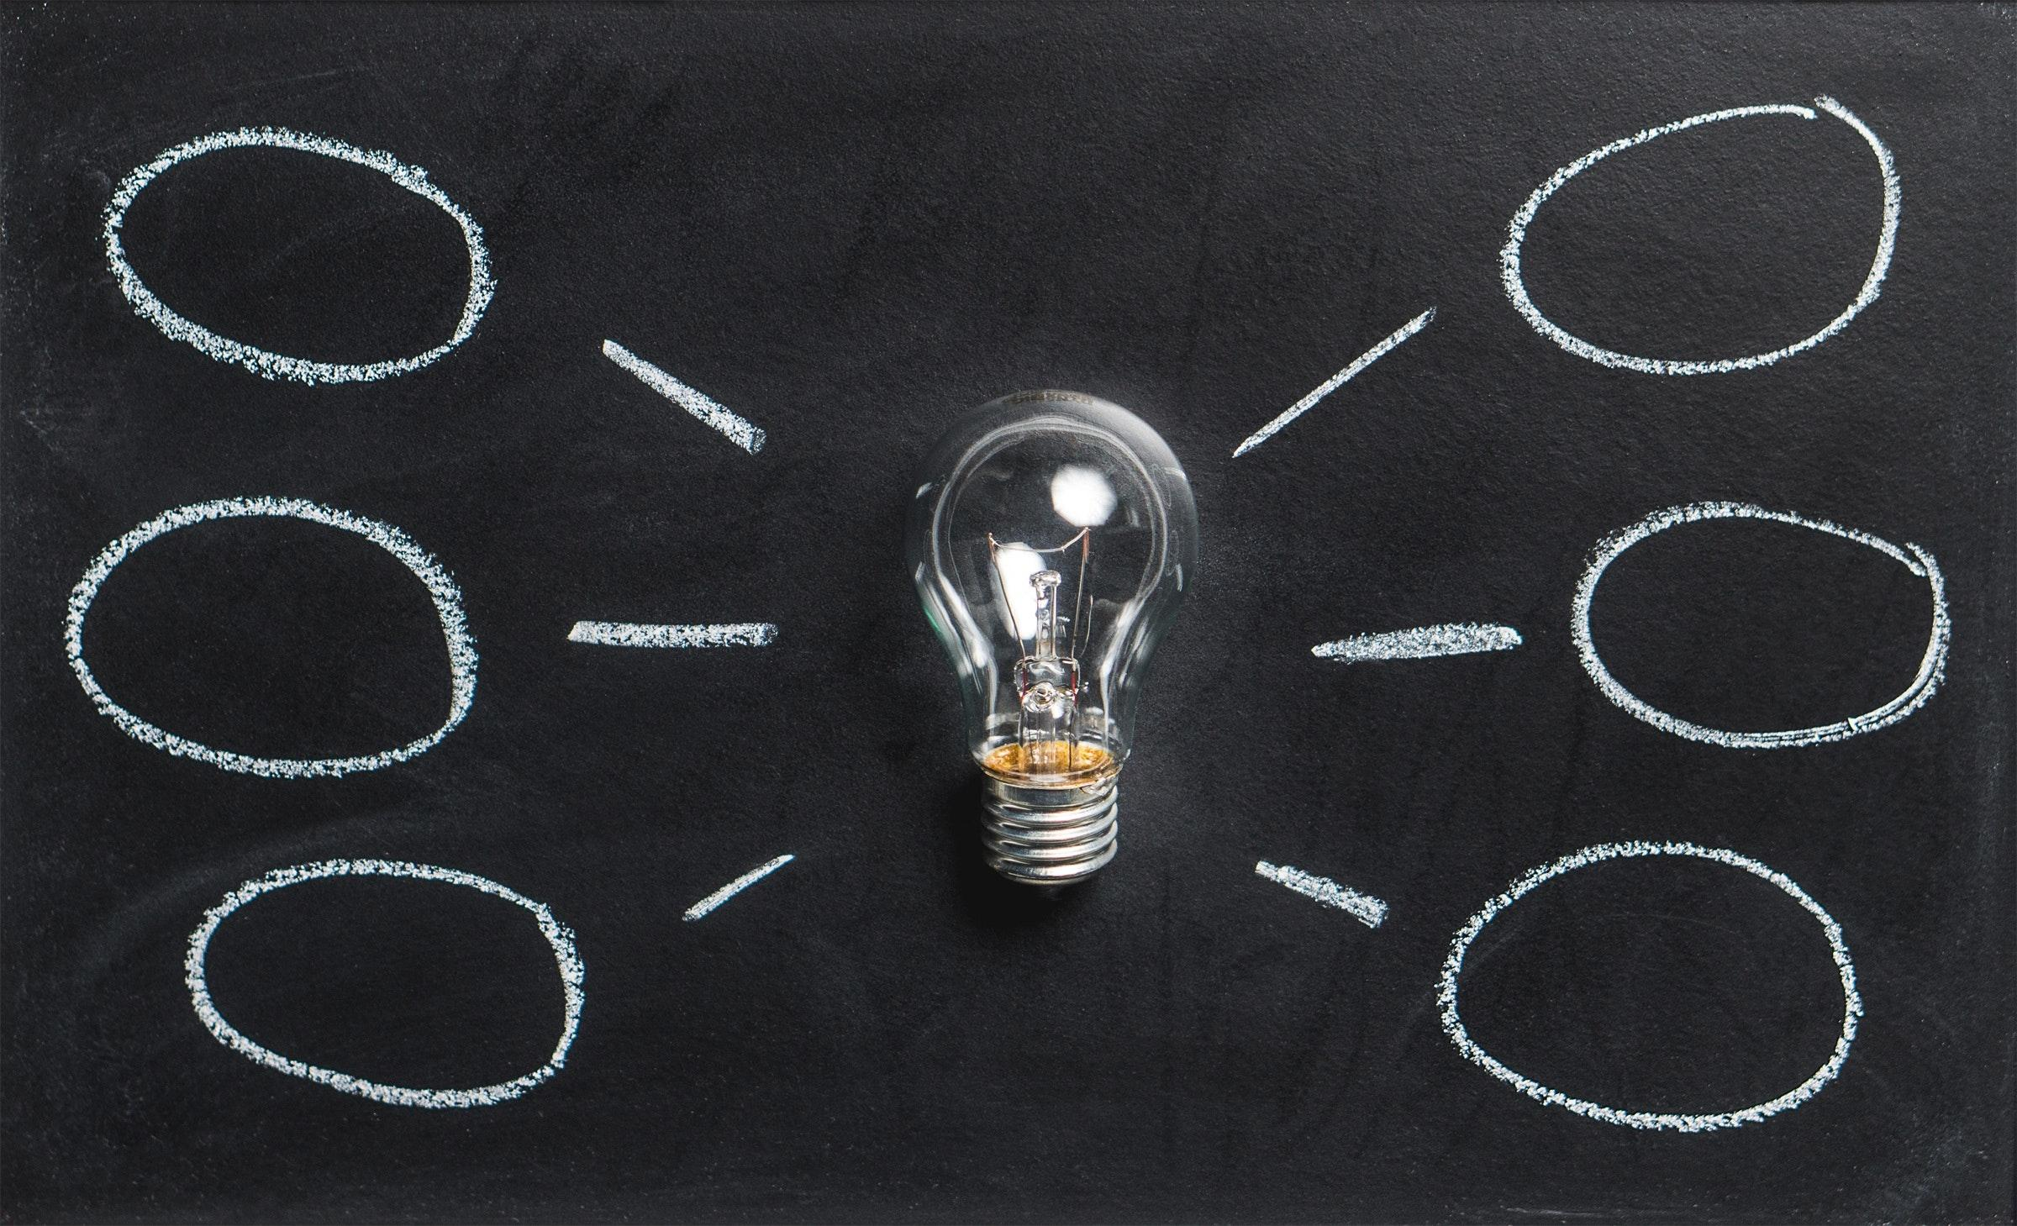
Implementation
AI Model
Data Collection and training
Backend
UX Design
Content type Customization
AI-powered proofreading and editing

Slide 7


Get content on your finger tips!!

Slide 8







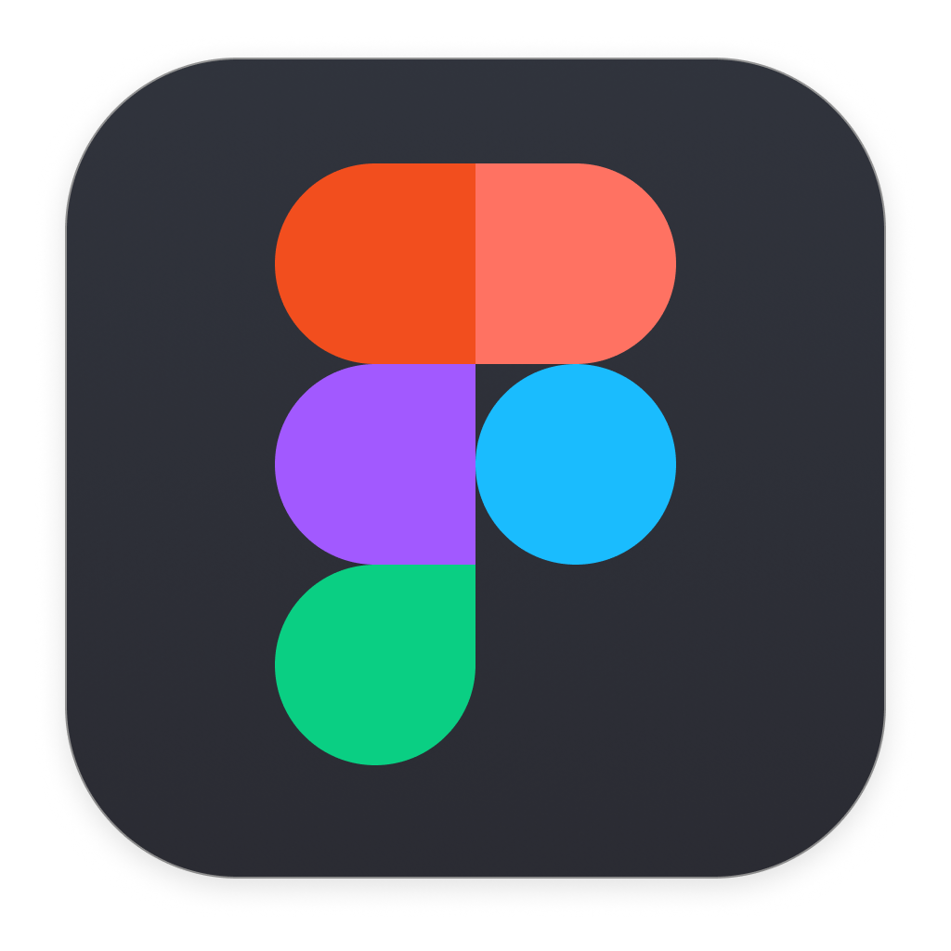

Tools and Technologies Required

Slide 9

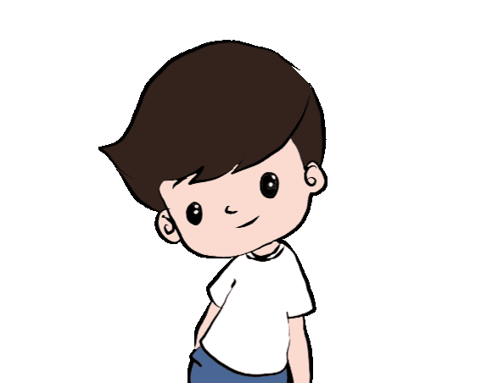
Blogging
Marketing Content
E-commerce
Content
News Articles
Social Media Content
Content Translation
Technical Writing
Academic Writing
Chat

Slide 10
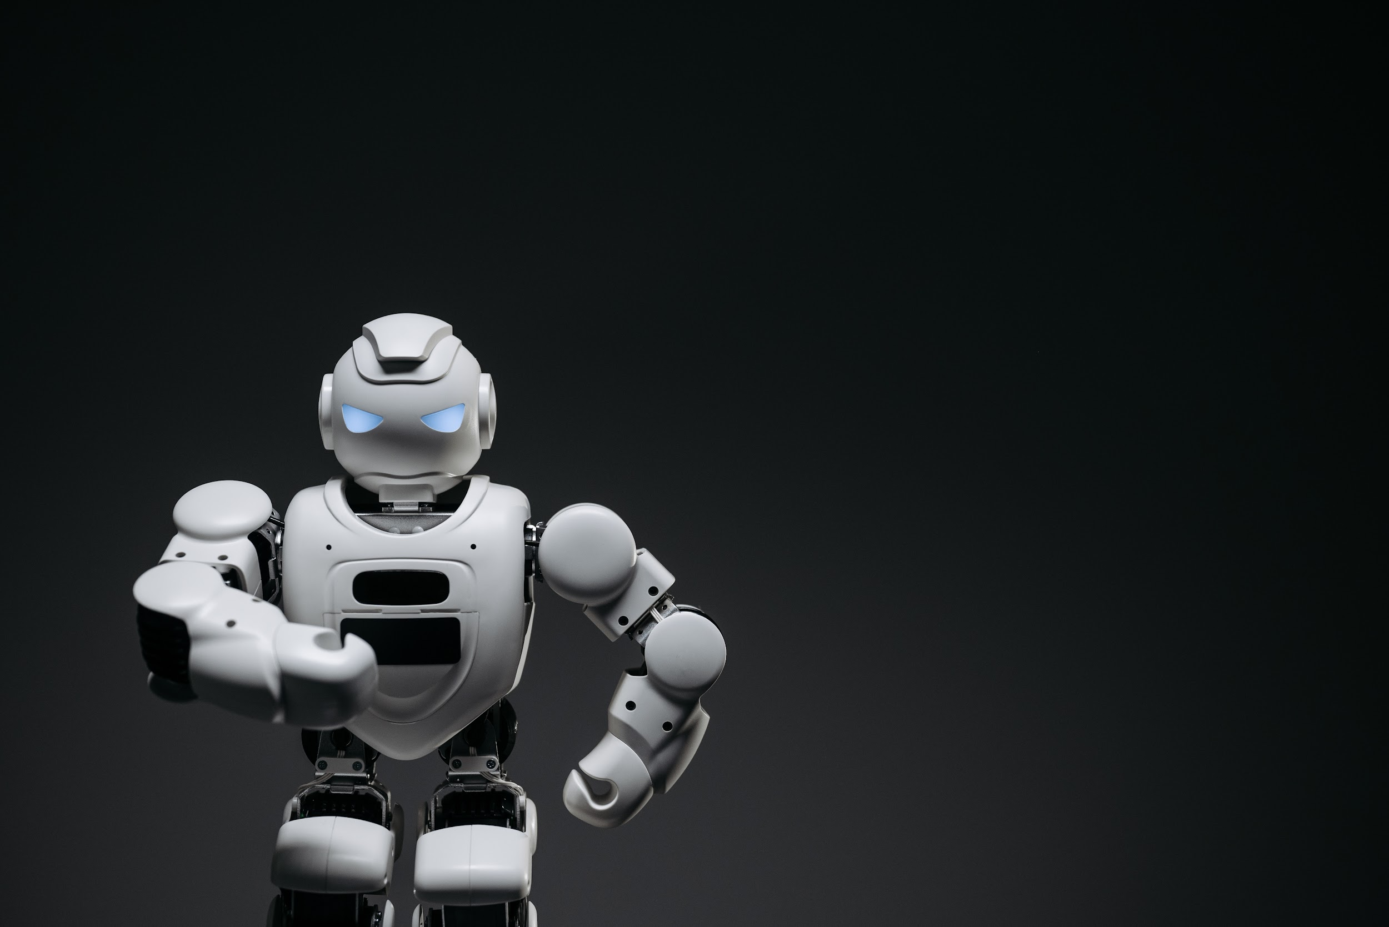
INTRODUCTION
Welcome to the forefront of innovation in Content Creation!!
SmartPenCraft is an endeavor that harnesses the power of cutting-edge artificial intelligence to revolutionize the art of content creation.
Continuous improvements and updates are woven into its DNA.

Slide 11
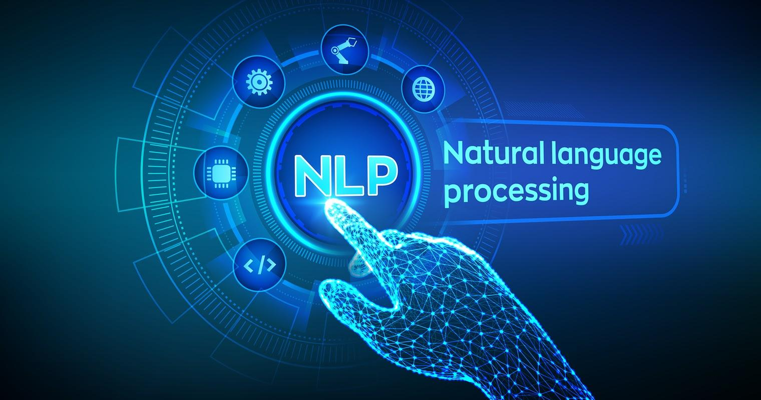
Chatbots and Virtual Assistants : Responds in a human-like manner.
NLP will focus on interaction between computer languages and human.
It can determine the sentiments of the people by their piece of text entered.
Information Retrieval
Speech Recognition
Named Entity Recognition(NER)
Language Learning

Slide 12


Enjoyable Experience!!

Slide 13

Error-free Content
Plagiarism Detection
User feedback Loop

Slide 14
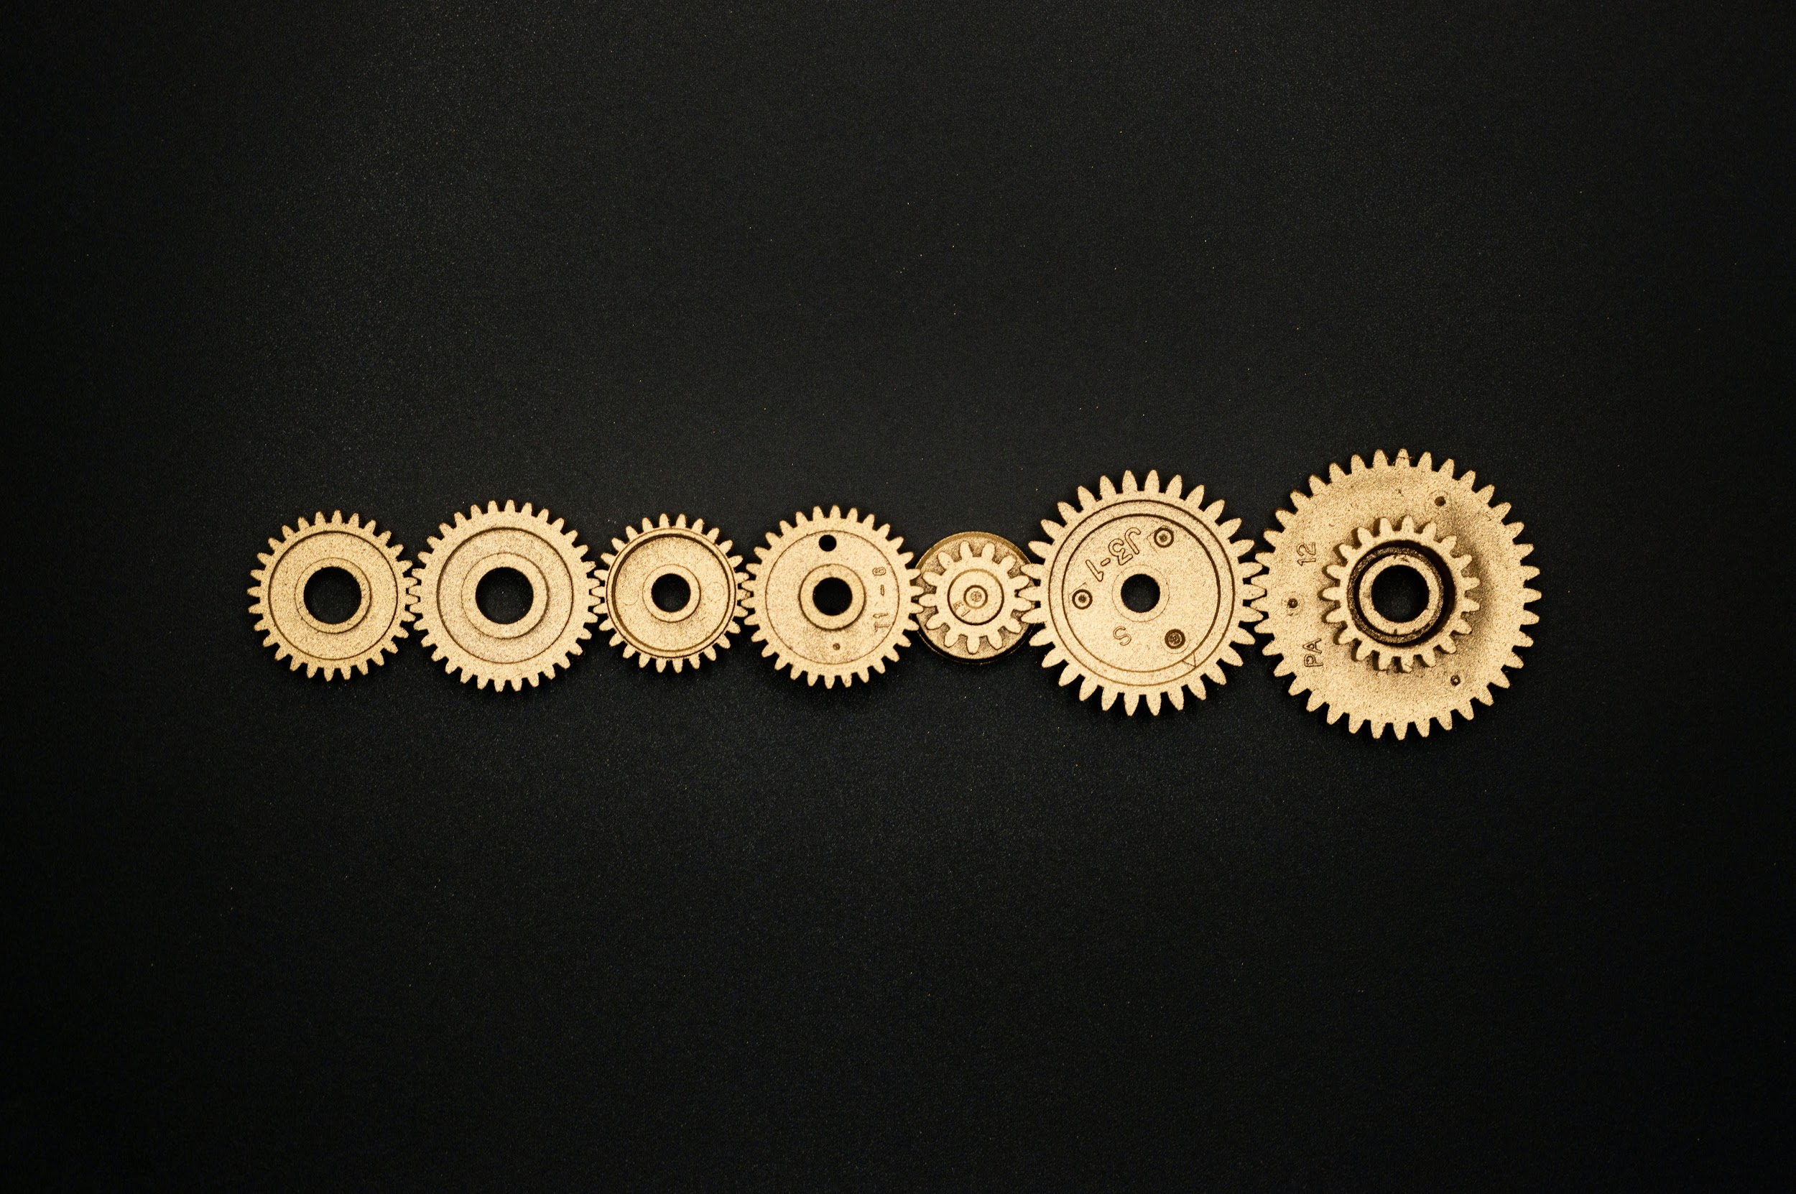

-Collaboration capabilities
-Easy to use
-Instant generation
-Its totally free!!
-Topic Suggestions
-Customer Support
-Personalization
-Responsive website

Slide 15

AI-model Integration
Server-side Processing
Authentication and security
API Endpoints

Slide 16
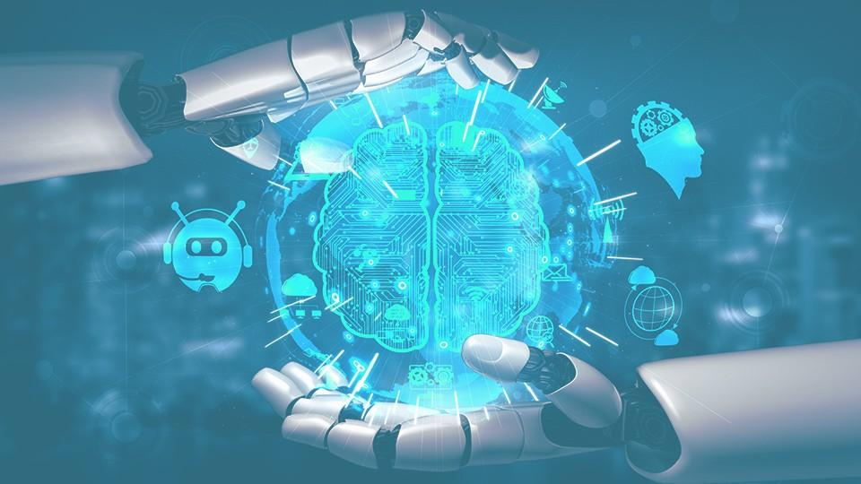


I believe this would be a great fit for my skills and aspirations.
I am reaching out to kindly request a chance to prove my abilities and dedication!!

